Slide 1
Introduction to Machine Learning

Slide 2
Introductions
Notes:
I want to get a feel for what people want to get out of the workshop
I want to get a feel for what people already know
I want people to get comfortable to ask and contradict
Finally – some scope – There’s far more kinds of machine learning than I’m going to get into. I’ll discuss some of the main ones very briefly, and then most of the workshop focusses on classification.

Slide 3
Technical Details
http://www.cs.waikato.ac.nz/ml/weka/
http://prdownloads.sourceforge.net/weka/datasets-UCI.jar
Notes:
Weka
Johan will install it
We’ll use Weka a few times on really simple things so that we know what we’re expecting and if the tech lets us down we know immediately

Slide 4
Exercise One - A toe in the water
At the end of the instructions you will see a matrix of scatter plots.
look at “class vs class” and experiment with “jitter”
Notes:
Start without anything other than their eyes and the Weka visualisation tool. Run an exercise

Slide 5
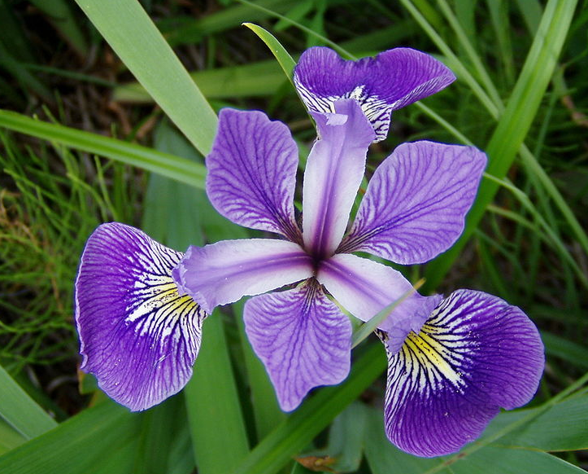
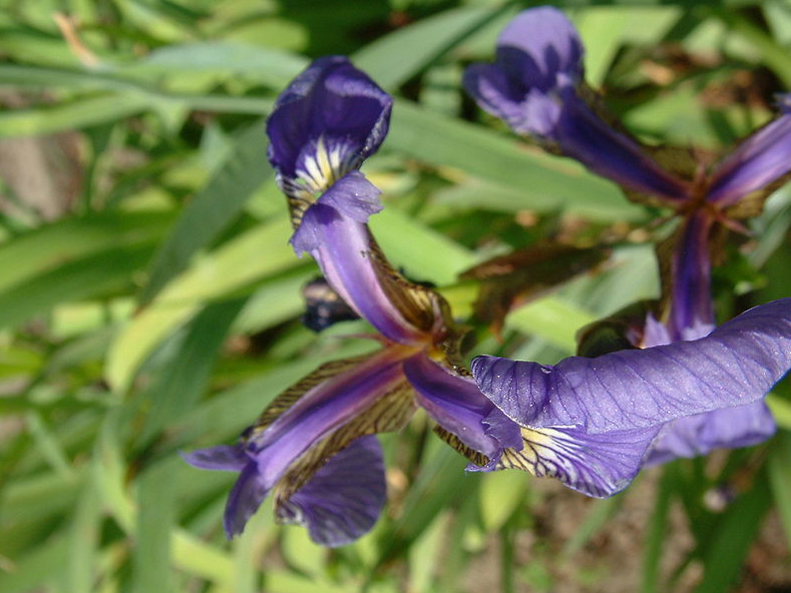
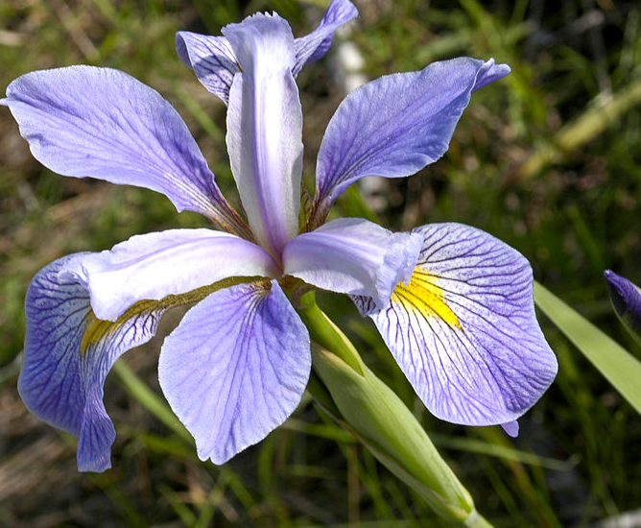
Iris – we’re going to get familiar with them
Versicolour
Virginica
Setosa
Notes:
Let’s start with an incredibly concrete example.
Let’s imagine that I told you that I had 150 iris flowers. And that I wanted you to sort them into their varieties. How do you go about doing that?
ask the class, they’ll have lots of ideas, for example
- they could read a book and work out the defining characteristics,
- they could phone a friend, and ask them to do it for them,
- they could purchase a gene sequencing facility, and run an analysis (maybe)
- they might look up images of the varieties on google images, and work off those images
- they might be lucky enough to have worked in a flower shop and be able to recognise them from past experience
- they might lie, or bluff, or oursource.
But it’s the penultimate one and the one before that that’s really interesting. It they’ve worked in a flower shop, then they will have experienced over time a huge number of examples of the various varieties of iris. The interesting thing about that earlier experience is that they probably came across a bunch of examples where they ALREADY HAD PROVIDED TO THEM the variety.
So now, let’s imagine that I go about this experiment differently. First, I’m going to give you 150 iris specimins with their labels, and leave you for a week. You’re not allowed to use the internet or other books. You can make measurements, etc. Then, after a week, I will give you a whole bunch of new irises, without the labels, and you are going to tell me what variety each one of them is. You’re allowed to make measurements again.
That, in a nutshell,is what machine learning is all about. It is about a machine using NOTHING BUT EXAMPLES, to derive a procedure by which new examples can be assigned properties.
Three disciplines’ examples:
Medical diagnosis – lots of sick people with well understood pathologies and results. They need a model because it takes 6 years to train a doctor.
Astronomy – lots of examples of labelled galaxies associated with radio spectra. Thye need a model because the sky is infinite

Slide 6
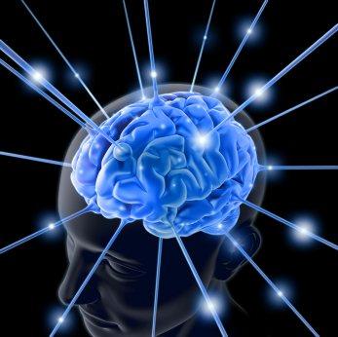


Some terminology
Model
Unlabeled Data
Learning Algorithm
Labeled Data
Notes:
Going to start to look at a few examples. They are all classifiers.
Terminology
– TRAINING SET
- TESTING SET (RECALL SET)
TRAINING
RECALL
- MODEL

Slide 7
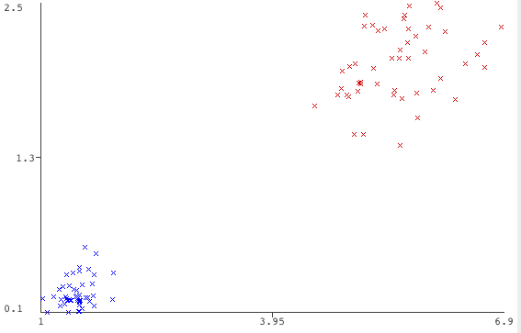
What is machine learning – motivating example
Notes:
Let’s then zoom out to the completely abstract.
Imagine that we had two kinds of things. I’ll represent “kind” by colour,
Imagine that we had lots of examples of those things, and we knew their kind. I’l represent examples by Xs

Slide 8
What is machine learning – motivating example
Notes:
Imagine that we had some more examples of things, and we didn’t know their kind.
Can we use the examples to help us decide what kind of things
Probably we’d all agree on two of them. Probably we’d not agree on the third.
So, in this example, our intuition says that there’s some hard and easy things to assign a “kind”
So far, you are the agent that’s doing the classification. You could do some “paper learning” by writing down a rule from the data, and throwing the data away, then using that rule.
I’m going to use a line to define that rule.

Slide 9
What is machine learning – motivating example
Notes:
Now that I’ve got the line, I can acutually throw away the examples. (But I won’t)

Slide 10
What is machine learning – motivating example
Notes:
Now that I have the line, I can say definitely that, while humans might equicocate about the colour of the central dot, my line doesn’t (Except for the ones that are on the line, but … well, just ignore that for a minute, you can handle that in practice)
In summary – there’s a lot of stuff you can take from that example. So here’s a summary.
The data, by the time it is processed, can almost always be presented as a bunch of points on a graph.
The attributes are each one dimension.
Weka singles out one of the attributes as “special”, it’s called the “class” and this will be very important
The scale of the attributes defines a (many) metric on the space.
Most “interesting” research is now in very high dimensionality. I can’t cover that here.
For classification (which is what we’re talking about most of the time, the job of a learner is very simple.
Some really important caveats –
don’t attempt to apply your intuition to high dimensionality
don’t confuse the sample with the population
distributions and scales are vitally important
A lot of this talk is really just very specific examples of the above points

Slide 11
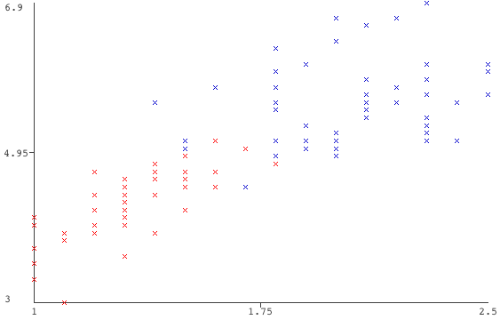
Some complications - separability
Notes:
These ones are hard to separate. We’d call them non-separable.
Actually, that’s only true if we restrict ourselves to straight lines.
The takeaway message is that in general, we can’t find a perfect classifier.
Two important classes
Linearly seperable
Non-linearly separable
All the interesting machine learning problems are non-linearly separable.

Slide 12
Some complications - separability
Notes:
These ones are hard to separate. We’d call them non-separable.
Actually, that’s only true if we restrict ourselves to straight lines.
The takeaway message is that in general, we can’t find a perfect classifier.
Two important classes
Linearly seperable
Non-linearly separable
All the interesting machine learning problems are non-linearly separable.

Slide 13
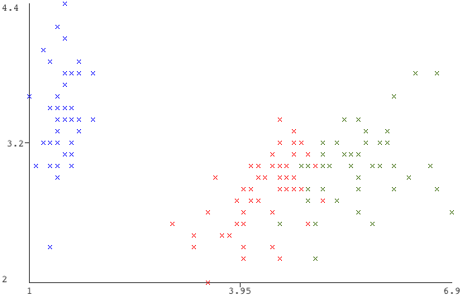
Some complications - > 2 classes
Notes:
When there’s more than two classes, our notion of “a single line” is not really up to scratch. But the general intuition holds.

Slide 14
What is machine learning?
Model
Unlabeled Data
Learning Algorithm
Labeled Data
Notes:
So now, we can try to define machine learning more formally. Not to do with any particular data points or domain.
Get some data
Pick/Develop and algorithm that can use as input *ONLY* that data.
Train the best model that you can
Use that model to assess other data
- What does the data look like – when is it right for machine learning (and classification in particular)
What learning algorithm is going to be useful (and what do learning algorithms actually do?)
How do you know when you havethe ‘best’ model that you can? What does best mean?
- What are some of the non-obvious (until you’ve done them) pitfalls
BIG PICTURE – WHY DO WE CARE

Slide 15
Training / Model Building
Model
Labeled Data
Notes:
You have a bunch of “training” or “labelled” instances. You know “everything” about them.
You build a “model” of the training data, that can later take “similar” instance, just without the “label”

Slide 16
Recall / Testing
Model
Unlabeled Data
Labeled Data
Notes:
Recall time – it’s about filling in the circles with a colour. i.e. providing a label
BIG PICTURE – WHY DO WE CARE

Slide 17
Why do we care?
Machines can
sometimes do things faster/better/longer/more repeatably than humans
be situated and replicated in difficult, dangerous, boring, on uninhabitable locations
Machine learning vs hand crafted
machines can discover some types of patterns better than us
can learn once situated
Lots of real-world problems can be cast as machine learning problems (how to do it is the take-away from this workshop)
Notes:
Some case studies – and a first chance to use WEKA.
Contact Lenses
Diabetes

Slide 18
What does the data look like?
Attribute
Sepal Length | Sepal Width | Petal Length | Petal Width | Variety
5.1 | 3.5 | 1.4 | 0.2 | Setosa
7.0 | 3.2 | 4.7 | 1.4 | Versicolor
7.1 | 3.0 | 5.9 | 2.1 | Virginica
7.6 | 3.0 | 6.6 | 2.1 | Virginica
… | … | … | … | …
Instance
Dataset
Notes:
For everything today, it looks like a table. DATASET, INSTANCE, ATTRIBUTE, TARGET ATTRIBUTE, DATA TYPES
NOMINAL,
NUMERIC,
STRING
We can visualise a dataset. It’s easiest if we pick three attributes and a target. (Although Nom
Back into WEKA- have a play with the IRIS dataset. It’s quite a good one to visualise – few attributes, some make it obvious that thngs are hard/easy.

Slide 19
Some kinds of machine learning
Attribute
Target
Sepal Length | Sepal Width | Petal Length | Petal Width | Variety
5.1 | 3.5 | 1.4 | 0.2 | Setosa
7.0 | 3.2 | 4.7 | 1.4 | Versicolor
7.1 | 3.0 | 5.9 | 2.1 | Virginica
7.6 | 3.0 | 6.6 | 2.1 | Virginica
… | … | … | … | …
Instance
Dataset
Notes:
This one is classification

Slide 20
Some (other) kinds of machine learning
Attribute
Target
Sepal Length | Sepal Width | Petal Length | Petal Width | Variety
5.1 | 3.5 | 1.4 | 0.2 | Setosa
7.0 | 3.2 | 4.7 | 1.4 | Versicolor
7.1 | 3.0 | 5.9 | 2.1 | Virginica
7.6 | 3.0 | 6.6 | 2.1 | Virginica
… | … | … | … | …
Instance
Dataset
Notes:
This one is estimation

Slide 21

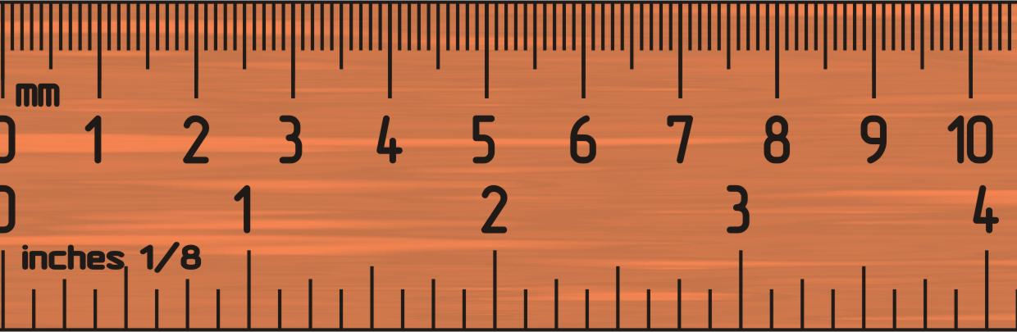
Some (other) kinds of machine learning
Notes:
Scaling from paired comparisons

Slide 22
What do the models and algorithms look like?
Model
Unlabeled Data
Learning Algorithm
Labeled Data
Notes:
It’s hard to pull them apart, in practice. Algorithms and models are quite tighly coupled in most cases.

Slide 23
What do the models look like?
In general, they can be any computable function from the “instance type” to the “target type”
In practice, each machine learning algorithm falls into a family where
a family has the same “kind of model”
the algorithm used to generate the model varies
different families have very different “kinds of models”
Some families’ models have a very intuitive interpretation (e.g. IBK, Decision Tree) and some do not (e.g. Neural Net)
Notes:
Which approach should I choose? I’ll just make a couple of points about each one.
training time
- recal time
- model complexity
- ‘accuracy’

Slide 24
Exercise – Let’s train and test a classifier
If you don’t still have Iris loaded, load it again
Click the “Classifier” tab
Click “Choose” and select Lazy -> IB1
In ‘Test Options’ choose “use training set”
Click “Start”
What just happened?
1. The IB1 learning algorithm was trained on the test data, producing a model
2. The model was tested against the training data, and its performance analysed
Notes:
Wow, look at the summary!!
We got everything right!!
What just happened?
By the end of this workshop, you’ll be able to critically evaluatie this example. For now, just bask in the glory of how easy Machine Learning is.

Slide 25
What algorithms will we examine today?
IBK (IB1 is the version of this with K = 1)
Decision Tree
Support Vector Machines
Notes:
What does the process of building a model look like – strengths, weaknesses
What does the model look like

Slide 26
IBK – what does a model look like?
Notes:
Really fast to learn
Models get really big
Can be quite slow to do ‘recall’ – indexing helps. But only in low dimensional spaces
Have to provide a “metric”
– what does distance mean? e.g. nominal. Scale of axes, etc. So it’s quite sensitive to represenation
-- K (how many neighbours). Smaller can be good.

Slide 27
IBK – what does the model building look like?
Store all the instances
Perhaps do some indexing (only works for low-dimensional spaces)
Remember the distance metric that you’re going to use
Remember K
PARAMETERS

Slide 28
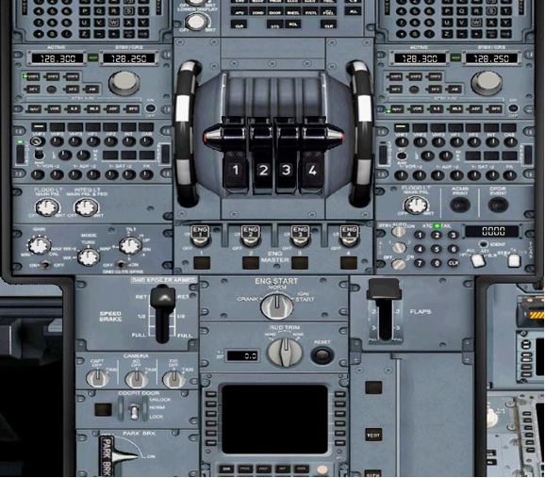
A note about parameters
Most algorithms have a bunch of parameters for you to fine-tune the algorithm to the problem.
Notes:
Formally – parameters are used to define a bunch of algorithms parametrically, but no-one really ever talks about it that way.
Informally, parameters are magic handles that you can use to fine tune your algorithm to your problem
The existance of these parameters brings a whole new approach (meta-learning by exploring the parameter space) which is, more or less, hackery. But quite effective.

Slide 29
IBK – how does it recall from a model?
Given an unlabelled instance
Find the K nearest neighbours in the training set, according to the distance metric
Return the most common label amongst those nearest neighbours

Slide 30
Exercise - Let’s Try IBK
Run IBK and experiment with different values for K
You can find it under “Lazy”
Note that all the results from your session are kept in the Explorer
You can click on the parameters of the learner to twiddle the parameters

Slide 31
Decision Tree – what does the model look like?
petalwidth <= 0.6: Iris-setosa (50.0)
petalwidth > 0.6
| petalwidth <= 1.7
| | petallength <= 4.9: Iris-versicolor (48.0/1.0)
| | petallength > 4.9
| | | petalwidth <= 1.5: Iris-virginica (3.0)
| | | petalwidth > 1.5: Iris-versicolor (3.0/1.0)
| petalwidth > 1.7: Iris-virginica (46.0/1.0)
Notes:
How do you choose what attributes to split on?
How do you choose what level of detail to ignore?
i.e. what are the numbers in the leaves?
Can take a long time to train
Very fast recall
Models are easy for humans to understand

Slide 32
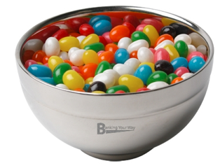
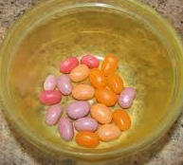
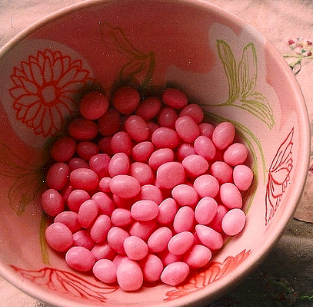
Jumbledness

Slide 33
Jumbledness
P(Pink) = 0.125
P(Yellow) = 0.125
P(Orange) = 0.125
P(Green) = 0.125
P(Red) = 0.125
P(Black) = 0.125
P(Green) = 0.125
P(Blue) = 0.125
P(Orange) = 0.5
P(Purple) = 0.35
P(Pink) = 0.15
P(Pink) = 1

Slide 34
Decision Trees – what does model building look like
How jumbled is a set of instances?
P(Red) = 0.5 P(Blue) = 0.5
Entropy = -0.5 * log(0.5) - 0.5 * log(0.5)
= -(0.5 * - 1) – (0.5*-1)
= 1
Notes:
It’s, like, maximally jumbled.

Slide 35
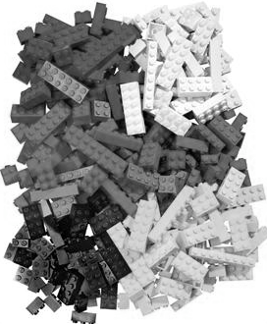
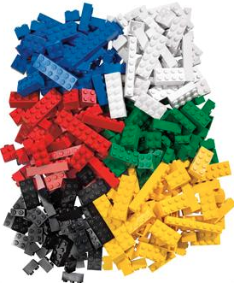
What helps resolve jumbledness?
Width?
Length?
Number of dots?

Slide 36
Decision Tree – what does model building look like
Given the attribute written in the middle of the circle……
There’s ways to split them up, like length of the string
Or the nature of the first letter (consonant / vowel)
abc
efgh
hijk
opqr
rst
ghi
efgh
hijk
opqr
abc
rst
ghi
abc
efgh
opqr
hijk
rst
ghi

Slide 37
Decision Tree – what does model building look like
Start with all the instances
Consider all the ways of splitting the instance into a number of groups
approach A
approach B
Keep the one that reduces entropy the most, then do that recursively for each node.
This is called maximising the information gain at each step
abc
efgh
hijk
opqr
rst
ghi
efgh
hijk
opqr
abc
rst
ghi
abc
efgh
opqr
hijk
rst
ghi

Slide 38
Decision Tree – what does model-building look like
Stop when further splitting doesn’t improve the entropy enough (or at all)
petalwidth <= 0.6: Iris-setosa (50.0)
petalwidth > 0.6
| petalwidth <= 1.7
| | petallength <= 4.9: Iris-versicolor (48.0/1.0)
| | petallength > 4.9
| | | petalwidth <= 1.5: Iris-virginica (3.0)
| | | petalwidth > 1.5: Iris-versicolor (3.0/1.0)
| petalwidth > 1.7: Iris-virginica (46.0/1.0)
http://en.wikipedia.org/wiki/List_of_important_publications_in_computer_science
Notes:
Invented by a Sydney University researcher who’s now a very rich man
Also the most cited Computer Scientist in Australia

Slide 39
Exercise - Let’s try it J48
Run the J-48 Decision Tree algorithm
This time, use n-fold cross validation
I’ll explain it later.
http://en.wikipedia.org/wiki/List_of_important_publications_in_computer_science

Slide 40
Support Vector Machines
Notes:
Can be very slow to learn Prone to numerical errors – have to invert a really large matrix (one row per instance, column per dimension)
Very flexible
Very large number of magic factors
Out of the box – only works on 2-class problems – we’ll ignore this until the ‘advanced’ section.
We can try it, but I’m not going into anything except the basic vibe. Explaine
that the problem “blue” vs “not blue” is an example of a linearly separable problem
there is a single “theoretcially optimal line” that separates these classes (the one that you can draw the widest rectangle through (at any angle)
the only important data points are the ones that are on the perimiter of that rectangle, when you draw it
they are the “support vectors”
Recall
Take an unlabelled instance
Compute its dot.product with the support vectors
Sum the values of the dot products
If positive, then class A, If negative, then class B

Slide 41
Section Two. Evaluation

Slide 42
Evaluation
How do I know which learning algorithm to choose?
You need to know what you need it to be good at
what are the characteristics of the situation where the learner and model will be situated?
what kinds of mistakes can we tolerate?
what kinds of correctness must we guarantee?
does training time matter?
does recall time matter?
does model size matter?
How do you come up with these numbers?
Notes:
It’s

Slide 43
Evaluation – Statistics are tricky, a cautionary tale
Let’s imagine that HIV runs at 1% in the community
Let’s imagine that we have a test for HIV that is 95% accurate
Let’s imagine that I return a positive test to HIV.
What is the probability that I have HIV?

Slide 44
Let’s build a confusion matrix
 | True Positive | True Negative
Test Positive | 190000 | 990000 | 1180000
Test Negative | 10000 | 18810000 | 18820000
 | 200000 | 19800000 | 20000000
Accuracy | 0.95
Prevalence | 0.01
What are my probabilities? | 0.161016949 | 0.838983051

Slide 45
Evaluation – Statistics are tricky, a cautionary tale
James and John are trivia buffs from rival towns, and very competitive, they want to find out who’s the best, so they’ll add up all the points they get this year.
They mostly play in their own town, but sometimes play at each-others’ pub
All pubs play games that have a maximum value of 100 points
At the end of the competition, James had a better average score at both towns’ competitions
Who had the best overall average score?

Slide 46
We don’t know, but it could have been John
TOWN A | James | John
Average Score | 98 | 90
Total Games | 5 | 100
Combined | James | John
Town A Points | 490 | 9000
Town B Points | 6800 | 300
Total Games | 105 | 105
Average | 69 | 89
TOWN B | James | John
Average Score | 68 | 60
Total Games | 100 | 5

Slide 47
Fundamental Performance Measures
Confusion Matrix
how often did the algorithm get confused between a pair of classes classes?
many other measurements can be derived
Accuracy (!)
Sensitivity (a.k.a True Positive Rate for binary problems)
Specificity (a.k.a 1 – False Positive Rate for binary problems)
ROC (receiver operating curve)
Sensitivity and Specificity are very important in medical diagnosis, and correspond to our intuitions of how accuracy “should behave”.

Slide 48
Confusion Matrix
a b c <-- classified as
50 0 0 | a = Iris-setosa
0 46 4 | b = Iris-versicolor
0 7 43 | c = Iris-virginica
Notes:
Accuracy
True Negative Rate (parameterised on class)
True positive rate
Sensitivity
Specificity

Slide 49
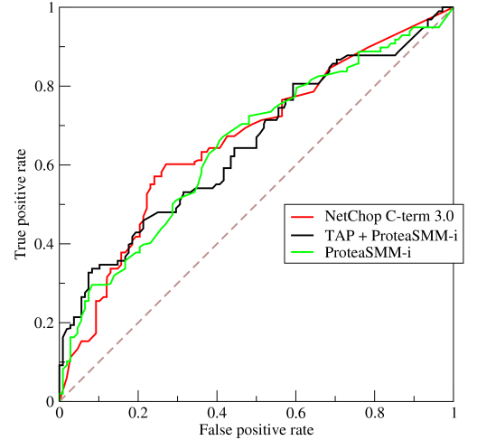
ROC Curves
Intuitively, you can imagine that True positive rate and False positive rate trade off against each other
That is, you can ‘fudge’ a high TPR by always returning TRUE
That is, you can ‘fudge’ a low FPR by never returning TRUE
Notes:
I’m going to give a intuition only (more or less)

Slide 50
Exercise – Run a learner now, and we can go through the output
Select a decision tree, and 10-fold evaulation
I’ll step you through what is happening
Look at the confusion matrix (what’s it based on? that comes later)
Look at the ROC curve (right-click on the result entry in the list, select “Threshold Curve”
I’m not going to go into great detail

Slide 51
Some other performance measures
How scrutable is your model?
How long does training take?
How long does recall take? (Average, Best, Worst)
How big is the model (IB-K)?
Can the model be incrementally updated?
Can the model be compiled or must it be interpreted?
Can the model degrade gracefully?
…

Slide 52
Evaluation – that was measurement, what about experiment design?

Slide 53
Evaluation – before you even think about evaluation, think about sampling
Notes:
Have I got a sample of points that are similarly distributed to the population
for the target especially (see above examples)
for the other attributes, too (think about IBK when you scale one dimension by a factor of 100
How will I get them

Slide 54
A few constraints
Data is often scarce
Data is often expensive
The amount of data required grows quickly as dimensionality increases
How do we
make the best possible model from the data available
measure how good it is

Slide 55
A basic approach – train and test
Use the whole dataset as the training set, and then test on that set, too.
hijk
abc
efgh
hijk
opqr
rst
ghi
abc
efgh
hijk
opqr
opqr
hijk
abc
rst
ghi
abc
efgh
opqr
abc
hijk
hijk
rst
ghi
Notes:
Why is this good: it builds the theoretically best learner (assuming your data is a representative sample)
Why is this bad: it gives a very bad estimate of how well the model performs (i.e. IBK)
Why is that important: you very rarely test exactly one learner – your goal is to find the best amongst some candidates

Slide 56
A slightly better approach – train and test
hijk
abc
efgh
hijk
opqr
rst
ghi
abc
efgh
hijk
opqr
opqr
hijk
abc
rst
ghi
abc
efgh
opqr
abc
hijk
hijk
rst
ghi
Notes:
Split up the datasets into two chunks
Train on one
Test on the other
There’s some subtlties.
The one above is a really bad split – the distributions of the target attribute are very different between the sets. Is the training set indicative of the testing set?
It doesn’t have to be 50/50
There’s a trade-off between accuracy of measurement (need a big training set) and representativeness of model based on training set vs model that would be built on twhole set

Slide 57
The ‘standard’ approach – n-fold cross validation
hijk
abc
efgh
hijk
opqr
rst
ghi
abc
efgh
hijk
opqr
opqr
hijk
abc
rst
ghi
abc
efgh
opqr
abc
hijk
hijk
rst
ghi
Notes:
For each fold
Take that fold and use it as the test set
Take the other folds, put them together, and use them as the training set
To estimate the validity of the approach, build a cumulative confusion matrix that is shared across folds
The degenerate case is called “leaving one out”
10-fold cross validation has become the “gold standard”, but really it’s just one way of going about it

Slide 58
The best, impossible, approach – leaving one out
hijk
abc
efgh
hijk
opqr
rst
ghi
abc
efgh
hijk
opqr
opqr
hijk
abc
rst
ghi
abc
efgh
opqr
abc
hijk
hijk
rst
ghi
Notes:
Why is this good: theoretically, you’re training on the most similar example to your actual domain
Why is this bad: it takes forever

Slide 59
So, in summary
If you want to know how well your model will work in the “real world” you have to
define what “well” means
work out a way to capture sufficient data to feed your algorithm
work out a way to ensure that the data represents the “real world”
work out an experiment design that preserves that representation and accurately evaluates your learning algorithm
be aware of the nature of your algorithms and what impact that has on your
sampling,
experimental design
metric choice

Slide 60
Final case study (and the end of the main body)
Let’s reconsider IB1 and why it got such good numbers?

Slide 61
Advanced Topics
Extending 2-class algorithms to multiclass algorithms
The kernel trick
Data representation and the curse of dimensionality

Slide 62
Multiclass Algorithms
Imagine that I had a learning algorithm that could only generate 2-class decisions
e.g. SVM
not, e.g. Decision Tree
There are two approaches that are ‘standard’ to boost these to multiclass learners
1 vs 1
1 vs rest
The algorithms have two parts: binarisation and debinarisation

Slide 63
Binarisation – happens at training time
Notes:
Brea your problem into a buncho f two-class problems

Slide 64
Binarisation – another approach – one-vs-rest

Slide 65
Debinarisation – happens at recall time

Slide 66
Distribution Learning
Some models can give more than a vote
petalwidth <= 0.6: Iris-setosa (50.0)
petalwidth > 0.6
| petalwidth <= 1.7
| | petallength <= 4.9: Iris-versicolor (48.0/1.0)
| | petallength > 4.9
| | | petalwidth <= 1.5: Iris-virginica (3.0)
| | | petalwidth > 1.5: Iris-versicolor (3.0/1.0)
| petalwidth > 1.7: Iris-virginica (46.0/1.0)
This makes it easier to combine them when debinarising
Notes:
Also worth considering how IBK might give a distribution

Slide 67
The kernel trick
Imagine you may draw only one line to separate these two classes. Where would you put it.
Notes:
http://www.youtube.com/watch?v=3liCbRZPrZA

Slide 68
Adding a dimension helps a lot

Slide 69
The kernel trick
The SVM algorithm works by comparing instances ONLY by computing their inner product (dot product)

Slide 70
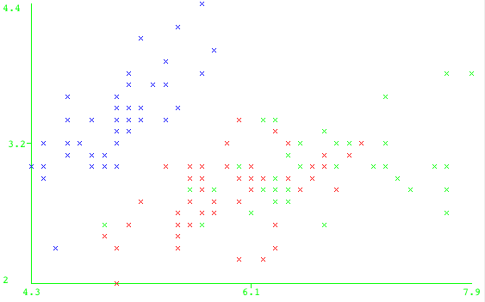
Dimensionality and Indexing
Consider indexing in the abstract – and some analogy
Notes:
Are there any points within ‘R’ of the circle. (Or similarly, what is the ‘R’ to the closest neighbour
Naïvely, we could just test everything.
But what if there was some way to just select candidates really quickly.

Slide 71
Dimensionality and Indexing
Consider indexing in the abstract – and it’s a fairly loose analogy, but please bear with me
Notes:
The squares are
fast to infer from a given point (a couple of modulo operations)
cheap to store with instances (i.e. you can keep around which training instances are in which square
only an approximartion of the circle (i.e. you pull in too many instances (i.e. the corners).

Slide 72
Thanks for attending!
Please complete our course survey at:
http://svy.mk/18c8dHa
Any further questions, contact us at
training@intersect.org.au
Find out about upcoming courses by signing up to our mailing list
http://bit.ly/1aZvRqw

